Slide 1

Petrol Price Analysis
G1

Slide 2
Malhar Kshirsagar
01
T
E
A
M
08
Harshwardhan More
Omkar More
09
11
Shubham Mulay
14
Vaishnavi Narkhede

Slide 3
01
Introduction
02
03
Literature Review
04
Technologies we’ll use
Relevance of Topic

Slide 4

DATA ANALYSIS
Data analysis is a process of inspecting, cleansing, transforming, and modelling data with the goal of discovering useful information, informing conclusions, and supporting decision-making.

Slide 5

INTRODUCTION
02
02
As petrol price are consistently changing. So there is need of certain analysis and everyone needs to know why they are fluctuating and must be aware of fuel economics

Slide 6
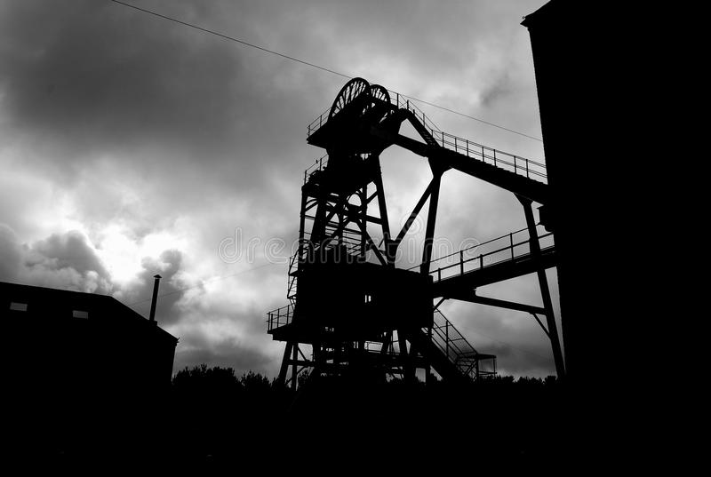
Relevance of topic

Slide 7
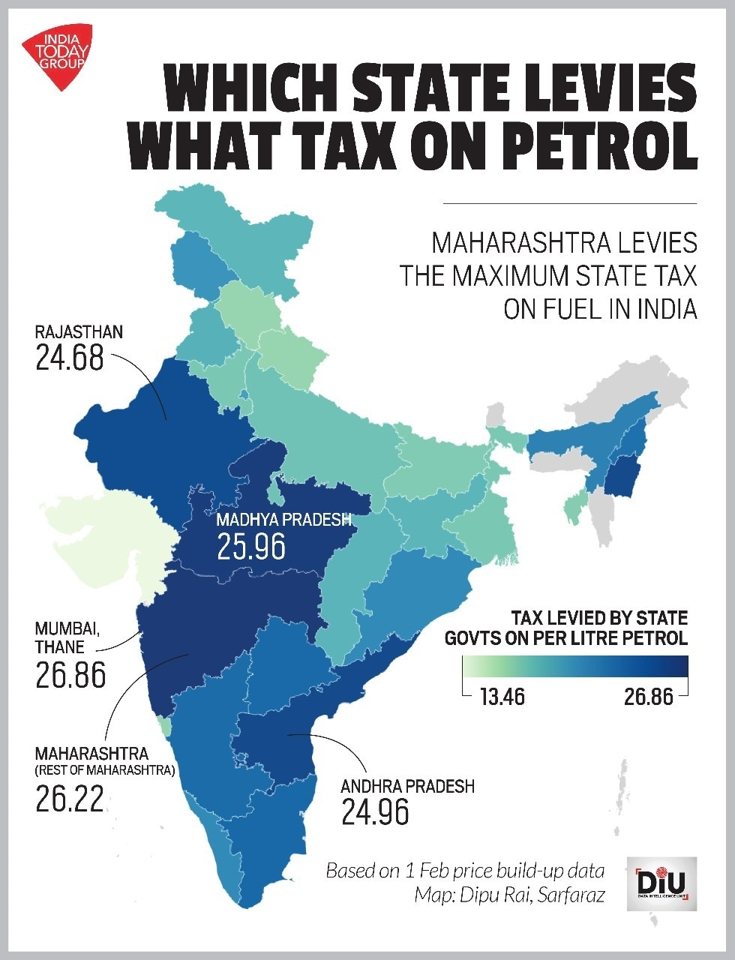
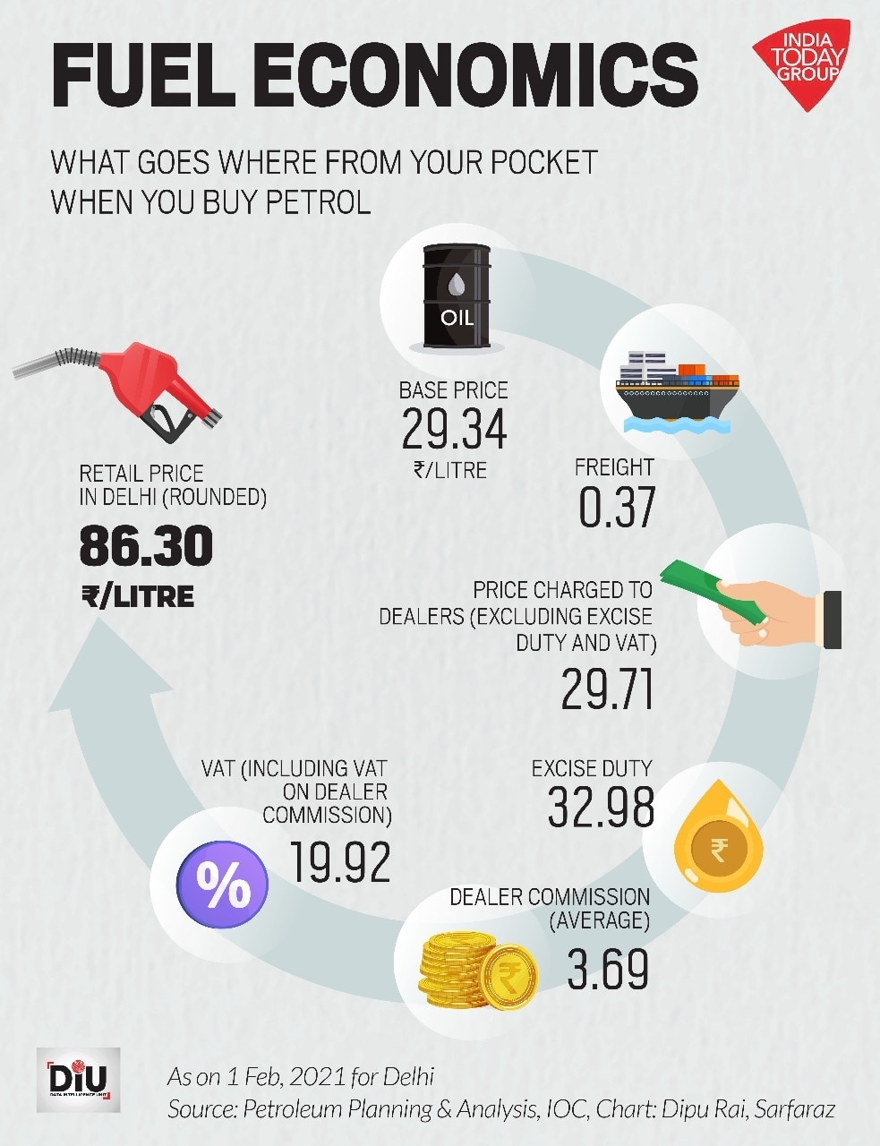
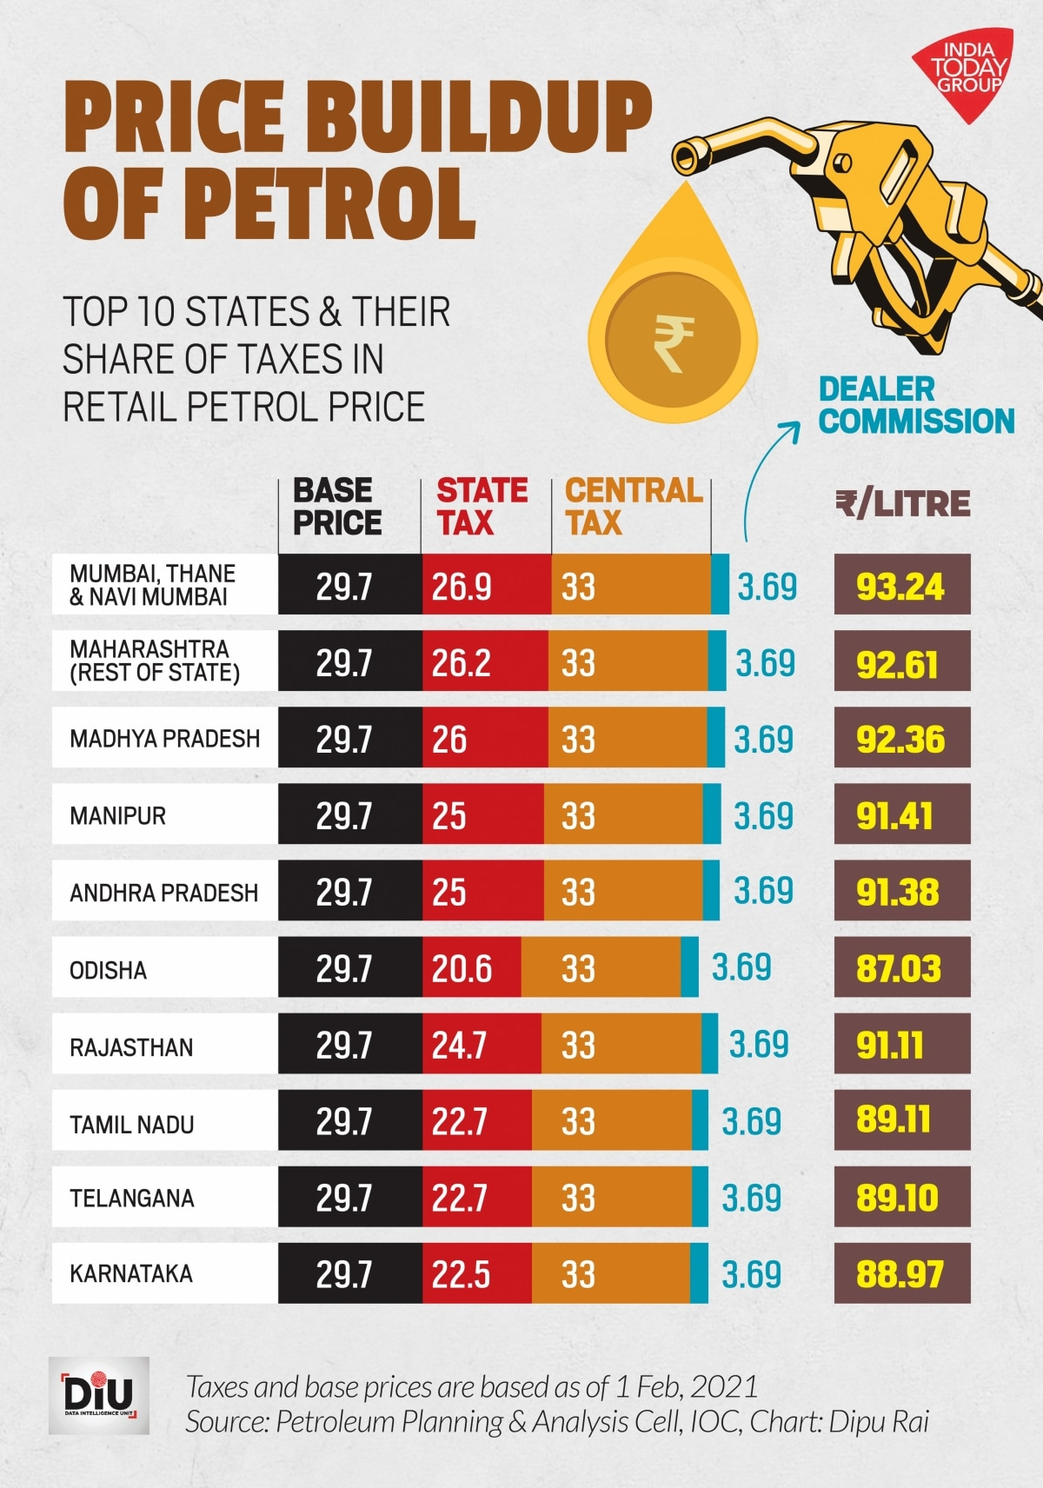

Slide 8
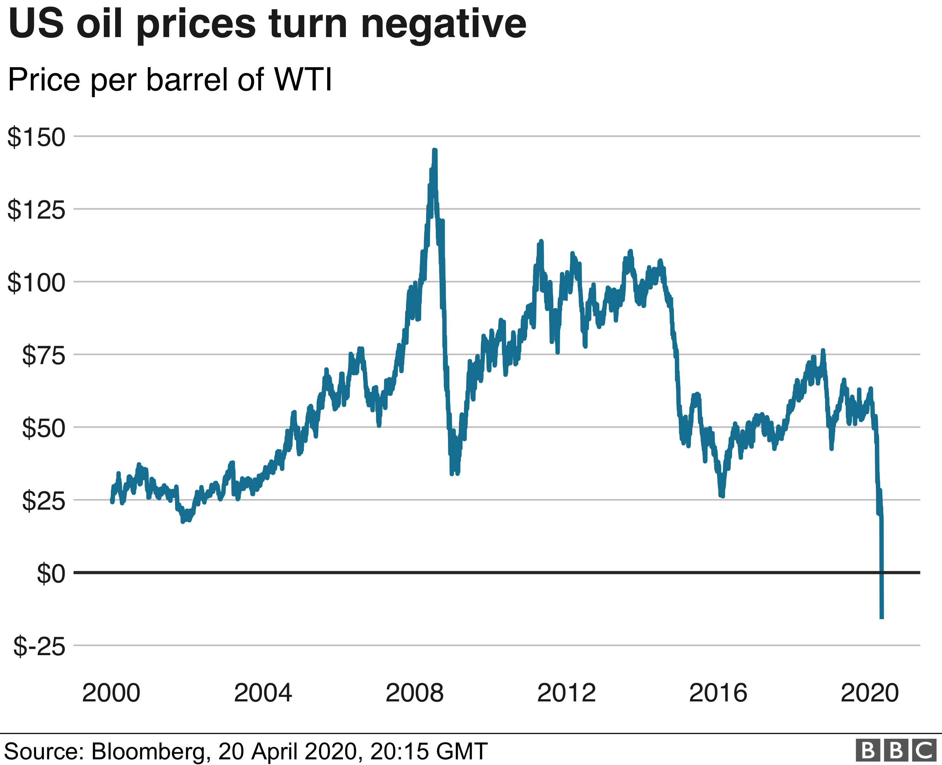
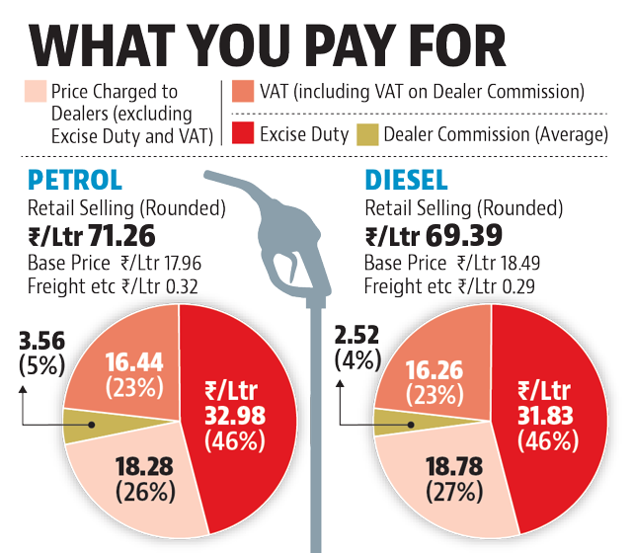

Slide 9
Rising prices of petrol and diesel in India since 2014
Sr. No. | Author | Objectives | Summary
1 | Dr. Dinesh Gabhane1 , Madhuri Gabhane | International crude oil prices has nothing to do with retail prices of petrol and diesel but the real culprit is taxation policy of both central and state government. | This paper attempts to study the causes for rising prices of petrol and diesel and its effect on Indian economy With the rapid growth in economy, India has been third largest importer of crude oil in the world Rising prices of crude oil put severe pressure on the economy, the cause being; demand and supply equation, hefty taxation levied by government on petroleum products and exchange rate of rupee against dollar It has been found that several implications in term of pushing up manufacturing cost; high inflation rate; low GDP growth, increase in current account deficit & fiscal imbalance, effect on industries and rise in transportation cost and essential commodities.

Slide 10
Petrol price analysis
Sr. No. | Author | Objectives | Summary
2 | Makumbonori Bristonea , Rajesh Prasadb,∗ , Adamu Ali Abubakara | Crude oil price prediction using complex network and deep learning algorithms | Model for crude oil price prediction that uses the complex network analysis and long short-term memory (LSTM) of the deep learning algorithms. LSTM is fit to the training data, it can be used to make predictions, The LSTM model can clearly predict the trend of crude oil price in the next time period.

Slide 11
NARX Based Forecasting of Petrol Prices
Sr. No. | Author | Summary
3 | Anita Thakur1 , Aishwarya Tiwari2 , Saswat Kumar3 , Aditya Jain4 , Jagjot Singh | The ability to accurately estimate the price of gasoline is critical in the global economy. For petrol price prediction, a method employing moving average, auto regression, and neural networks has been proposed. Any series' trend is measured using a moving average and the NARX time series programmed. They can be used for both linear and non-linear trends. The ability of neural networks to construct flexible approximation functional correlations between inputs and outputs data. A strong and very accurate model for predicting gas price is created by combining moving average with NARX.

Slide 12
Fuel Price Prediction Using RNN
Sr. No. | Author | Summary
4 | Chaitanya Lahari M, Dhakate Hardik Ravi, R Bharathi | The established model forecasts fuel prices for the following day in key metropolises such as Chennai, Delhi, Mumbai, and Kolkata. The previous prices in these cities are kept up to current, and the next day's fuel prices are forecasted based on the price of an international Brent oil barrel and exchange rates. In order to forecast the future one-week pricing, the input parameters are also tail extrapolated. The approach, however, has the following limitations: the forecast is totally dependent on the daily updating of datasets. Predictions are inaccurate if the dataset is out of date. Furthermore, the method is unable to detect price swings with sharp increases or decreases that may be caused by political imbalances or other circumstances. It may be determined from the data that the anticipated values are pretty close to the actual prices. For next-day prices, the model's accuracy is above 90%, and for one-week forecasts, it's above 80%. As a result, using recurrent neural networks to regression issues allows for high accuracies, making them effective

Slide 13
Name of Paper
Sr. No. | Author | Objectives | Summary
1

Slide 14
Name of Paper
Sr. No. | Author | Objectives | Summary
1

Slide 15
Name of Paper
Sr. No. | Author | Objectives | Summary
1

Slide 16
OUR MOTIVE
EDA
To provide detailed analysis which is done by considering most of features directly affecting to price
Exploratory Data Analysis
Graphical visualizations
Visualisation

Slide 17
Tools & Technologies
R Programming
GG Plot 2
EDA
Data Visualisation
Kaggle
Data Set

Slide 18
Thank You

